Slide 1
Abtract Data Type (ADT)
atjahyanto@gmail.com

Slide 2
Abstract Data Type (ADT)
Deskripsi tingkat tinggi dari struktur data dan operasi yang dapat dilakukan di atasnya, tanpa menentukan detail implementasi yang sebenarnya.
Bag
Dictionary
List
Set
Graph
Tree
Hash
Queue
Stack
Heap
…

Slide 3
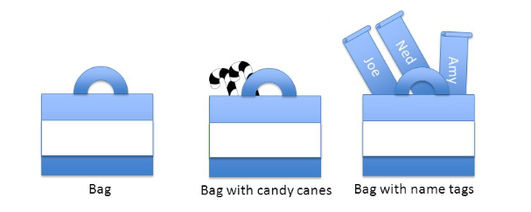
Bag ADT
Berfokus pada operasi yang melibatkan penambahan elemen dan menghitung kemunculannya
Tidak terurut, boleh campur-campur, multi-set
Operasi :
Add (Insert)
Remove
Count
Size
Is Empty

Slide 4
Bag ADT
Save as BagADT.java
$ javac BagADT.java
$ java BagADT
class BagADT:
def __init__(self):
self.bag = {} # Dictionary to store element counts
def add(self, item):
if item in self.bag:
self.bag[item] += 1
else:
self.bag[item] = 1
def remove(self, item):
if item in self.bag:
if self.bag[item] > 1:
self.bag[item] -= 1
else:
del self.bag[item]
def count(self, item):
return self.bag.get(item, 0)
def size(self):
return sum(self.bag.values())
def is_empty(self):
return len(self.bag) == 0
# Example usage
bag = BagADT()
bag.add('apple')
bag.add('apple')
bag.add('banana')
bag.add('orange')
bag.add('apple')
print("Count of apples:", bag.count('apple')) # Output: Count of apples: 3
print("Count of bananas:", bag.count('banana')) # Output: Count of bananas: 1
print("Size of bag:", bag.size()) # Output: Size of bag: 5
bag.remove('apple')
print("Count of apples after removal:", bag.count('apple')) # Output: Count of apples after removal: 2
print("Is bag empty?", bag.is_empty()) # Output: Is bag empty? False
import java.util.HashMap;
import java.util.Map;
public class BagADT {
private Map<Object, Integer> bag;
public BagADT() {
bag = new HashMap<>();
}
public void add(Object item) {
bag.put(item, bag.getOrDefault(item, 0) + 1);
}
public void remove(Object item) {
if (bag.containsKey(item)) {
int count = bag.get(item);
if (count > 1) {
bag.put(item, count - 1);
} else {
bag.remove(item);
}
}
}
public int count(Object item) {
return bag.getOrDefault(item, 0);
}
public int size() {
int totalSize = 0;
for (int count : bag.values()) {
totalSize += count;
}
return totalSize;
}
public boolean isEmpty() {
return bag.isEmpty();
}
public static void main(String[] args) {
BagADT bag = new BagADT();
bag.add("apple");
bag.add("apple");
bag.add("banana");
bag.add("orange");
bag.add("apple");
System.out.println("Count of apples: " + bag.count("apple")); // Output: Count of apples: 3
System.out.println("Count of bananas: " + bag.count("banana")); // Output: Count of bananas: 1
System.out.println("Size of bag: " + bag.size()); // Output: Size of bag: 5
bag.remove("apple");
System.out.println("Count of apples after removal: " + bag.count("apple")); // Output: Count of apples after removal: 2
System.out.println("Is bag empty? " + bag.isEmpty()); // Output: Is bag empty? false
}
}
Python
Java

Slide 5
Bag ADT
Implementation of Bag
Grocery Shopping
Library Book Checkout
Customer Orders
Collecting Items
…

Slide 6
Dictionary ADT
student_scores = {'Alice': 85, 'Bob': 92, 'Charlie': 78, 'David': 95}
Representasi abstrak dari struktur data yang menyimpan kumpulan pasangan key-value.
Setiap key dalam dictionary adalah unik dan dipetakan ke nilai yang sesuai.
Value dapat berupa ADT lainnya
Juga dikenal sebagai “map" atau “associative array"
Operasi :
Insert
Update
Delete
Access
Iterate
IsExists

Slide 7
Dictionary ADT
Save as DictionaryADTExample.java
$ javac DictionaryADTExample.java
$ java DictionaryADTExample
import java.util.HashMap;
import java.util.Map;
public class DictionaryADTExample {
public static void main(String[] args) {
// Creating a dictionary using HashMap
Map<String, Integer> studentScores = new HashMap<>();
// Inserting key-value pairs
studentScores.put("Alice", 85);
studentScores.put("Bob", 92);
studentScores.put("Charlie", 78);
studentScores.put("David", 95);
// Accessing values using keys
int aliceScore = studentScores.get("Alice");
System.out.println("Alice's score: " + aliceScore);
// Updating a value
studentScores.put("Charlie", 80);
// Inserting a new key-value pair
studentScores.put("Eve", 88);
// Removing a key-value pair
studentScores.remove("David");
// Checking for key existence
if (studentScores.containsKey("Bob")) {
System.out.println("Bob's score: " + studentScores.get("Bob"));
}
// Iterating over keys and values
for (Map.Entry<String, Integer> entry : studentScores.entrySet()) {
System.out.println(entry.getKey() + ": " + entry.getValue());
}
}
}
# Using the Dictionary ADT in Python
# Creating a dictionary
student_scores = {'Alice': 85, 'Bob': 92, 'Charlie': 78, 'David': 95}
# Accessing values
alice_score = student_scores['Alice']
print("Alice's score:", alice_score) # Output: Alice's score: 85
# Updating a value
student_scores['Charlie'] = 80
# Inserting a new key-value pair
student_scores['Eve'] = 88
# Deleting a key-value pair
del student_scores['David']
# Checking for key existence
if 'Bob' in student_scores:
print("Bob's score:", student_scores['Bob'])
# Iterating over keys and values
for name, score in student_scores.items():
print(f"{name}: {score}")
Python
Java

Slide 8

Dictionary ADT
Implementation of Dictionary
Product Catalogs
Inventory Management
Airport Flight Information
Word Frequency Analysis
Dictionary Lookup
Caching Web Pages
…

Slide 9
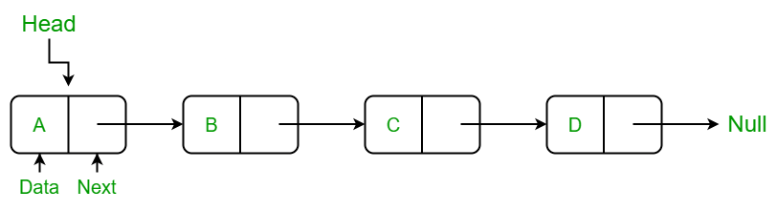
List ADT
Menyimpan kumpulan elemen secara urut
import java.util.ArrayList;
import java.util.List;
public class ListADTExample {
public static void main(String[] args) {
// Creating a list using ArrayList
List<Integer> myArrayList = new ArrayList<>();
// Insertion
myArrayList.add(1); // Add at the end
myArrayList.add(2);
myArrayList.add(3);
myArrayList.add(4);
myArrayList.add(5);
// Deletion
myArrayList.remove(Integer.valueOf(3)); // Remove the value 3
// Access
int thirdElement = myArrayList.get(2); // Access element at index 2
// Update
myArrayList.set(1, 8); // Update element at index 1
// Search
int indexOf4 = myArrayList.indexOf(4); // Get index of value 4
// Size
int listSize = myArrayList.size(); // Get the number of elements
// Iteration
for (int element : myArrayList) {
System.out.println(element);
}
}
}
# Using the List ADT with Python's built-in list type
# Creating a list
my_list = [1, 2, 3, 4, 5]
# Insertion
my_list.append(6) # Add at the end
my_list.insert(2, 7) # Add at index 2
# Deletion
my_list.remove(3) # Remove the value 3
# Access
third_element = my_list[2] # Accessing element at index 2
# Update
my_list[1] = 8 # Update element at index 1
# Search
index_of_4 = my_list.index(4) # Get index of value 4
# Size
list_size = len(my_list) # Get the number of elements
# Iteration
for element in my_list:
print(element)
Operasi :
Insert
Update
Delete
Access
Iterate
Search
Size

Slide 10
List ADT
Implementation of List
Shopping Lists
To-do lists
Contact lists
Checklists
Call logs
…

Slide 11
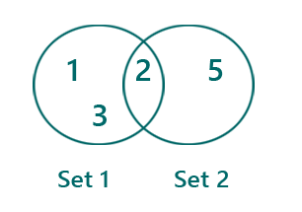
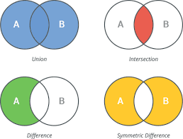
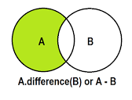
Set ADT
Operasi :
Insert
Delete
Containment Check
Size
Union
Intersection
Difference
Menyimpan kumpulan elemen unik tanpa urutan tertentu
Tidak mengizinkan nilai double atau duplikat

Slide 12
Set ADT
import java.util.HashSet;
import java.util.Set;
public class SetADTExample {
public static void main(String[] args) {
// Creating sets using HashSet
Set<Integer> setA = new HashSet<>();
Set<Integer> setB = new HashSet<>();
// Insertion
setA.add(1);
setA.add(2);
setA.add(3);
setA.add(4);
setA.add(5);
setB.add(4);
setB.add(5);
setB.add(6);
setB.add(7);
setB.add(8);
// Deletion
setA.remove(3);
// Containment check
if (setA.contains(2)) {
System.out.println("2 is in setA");
}
// Size
int sizeOfSetA = setA.size();
// Union (addAll)
Set<Integer> unionSet = new HashSet<>(setA);
unionSet.addAll(setB);
// Intersection (retainAll)
Set<Integer> intersectionSet = new HashSet<>(setA);
intersectionSet.retainAll(setB);
// Difference (removeAll)
Set<Integer> differenceSet = new HashSet<>(setA);
differenceSet.removeAll(setB);
System.out.println("Set A: " + setA);
System.out.println("Set B: " + setB);
System.out.println("Union Set: " + unionSet);
System.out.println("Intersection Set: " + intersectionSet);
System.out.println("Difference Set: " + differenceSet);
}
}
# Using the Set ADT with Python's built-in set type
# Creating sets
set_a = {1, 2, 3, 4, 5}
set_b = {4, 5, 6, 7, 8}
# Insertion
set_a.add(6)
# Deletion
set_a.remove(3)
# Containment check
if 2 in set_a:
print("2 is in set_a")
# Size
size_of_set_a = len(set_a)
# Union
union_set = set_a.union(set_b)
# Intersection
intersection_set = set_a.intersection(set_b)
# Difference
difference_set = set_a.difference(set_b)
print("Set A:", set_a)
print("Set B:", set_b)
print("Union Set:", union_set)
print("Intersection Set:", intersection_set)
print("Difference Set:", difference_set)

Slide 13
Set ADT
Implementation of Set
Membership and Deduplication
Voting and Survey Responses
Word Frequency Count
Etc that need avoiding duplicate entries
…

Slide 14
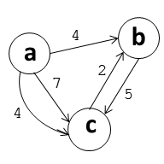
Graph ADT
Sebuah graf terdiri dari simpul-simpul (vertices) yang dihubungkan oleh edge, dimana edge merepresentasikan hubungan atau koneksi antar node
Operasi :
Add Vertex
Add Edge
Remove Vextex
Remove Edge
Get Neighbors
Traversal
Shortest Path
Cycle Detection
Directed Graph (Digraph)
Undirected Graph
Weighted Graph
Unweighted Graph
Cyclic Graph
Acyclic Graph
Connected Graph
Disconnected Graph

Slide 15
Graph ADT
import java.util.*;
class GraphADT {
private Map<String, List<String>> graph;
public GraphADT() {
graph = new HashMap<>();
}
public void addVertex(String vertex) {
graph.put(vertex, new ArrayList<>());
}
public void addEdge(String vertex1, String vertex2) {
if (graph.containsKey(vertex1) && graph.containsKey(vertex2)) {
graph.get(vertex1).add(vertex2);
graph.get(vertex2).add(vertex1);
}
}
public void dfs(String startVertex) {
Set<String> visited = new HashSet<>();
dfsRecursive(startVertex, visited);
}
private void dfsRecursive(String vertex, Set<String> visited) {
if (!visited.contains(vertex)) {
System.out.print(vertex + " ");
visited.add(vertex);
for (String neighbor : graph.get(vertex)) {
dfsRecursive(neighbor, visited);
}
}
}
public static void main(String[] args) {
GraphADT graph = new GraphADT();
graph.addVertex("A");
graph.addVertex("B");
graph.addVertex("C");
graph.addVertex("D");
graph.addEdge("A", "B");
graph.addEdge("A", "C");
graph.addEdge("B", "D");
graph.addEdge("C", "D");
System.out.println("Depth-First Traversal:");
graph.dfs("A");
}
}
class GraphADT:
def __init__(self):
self.graph = {}
def add_vertex(self, vertex):
if vertex not in self.graph:
self.graph[vertex] = []
def add_edge(self, vertex1, vertex2):
if vertex1 in self.graph and vertex2 in self.graph:
self.graph[vertex1].append(vertex2)
self.graph[vertex2].append(vertex1)
def dfs(self, start_vertex):
visited = set()
self._dfs_recursive(start_vertex, visited)
def _dfs_recursive(self, vertex, visited):
if vertex not in visited:
print(vertex, end=' ')
visited.add(vertex)
for neighbor in self.graph[vertex]:
self._dfs_recursive(neighbor, visited)
# Example usage
graph = GraphADT()
graph.add_vertex('A')
graph.add_vertex('B')
graph.add_vertex('C')
graph.add_vertex('D')
graph.add_edge('A', 'B')
graph.add_edge('A', 'C')
graph.add_edge('B', 'D')
graph.add_edge('C', 'D')
print("Depth-First Traversal:")
graph.dfs('A')

Slide 16
Graph ADT
Implementation of Graph
Social Networks
Transportation Networks
Internet and Web
Circuit Design
Dependency Management
Flight Routes and Airline Networks
Project Management
Collaboration Networks
…

Slide 17
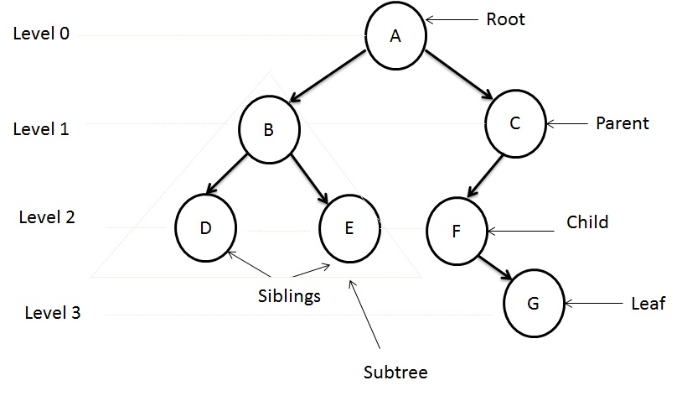
Tree ADT
Terdiri dari node yang dihubungkan oleh edge, dimana setiap node dapat memiliki parent node dan nol atau lebih child node.
Mewakili struktur hierarkis seperti bagan organisasi
Operasi :
Insert
Delete
Traversal
Search
Height
Balancing

Slide 18
Tree ADT
class TreeNode {
int value;
TreeNode left;
TreeNode right;
public TreeNode(int value) {
this.value = value;
this.left = null;
this.right = null;
}
}
class BinarySearchTreeADT {
private TreeNode root;
public BinarySearchTreeADT() {
this.root = null;
}
public void insert(int value) {
root = insertRecursive(root, value);
}
private TreeNode insertRecursive(TreeNode current, int value) {
if (current == null) {
return new TreeNode(value);
}
if (value < current.value) {
current.left = insertRecursive(current.left, value);
} else if (value > current.value) {
current.right = insertRecursive(current.right, value);
}
return current;
}
public void inorderTraversal() {
inorderTraversal(root);
}
private void inorderTraversal(TreeNode node) {
if (node != null) {
inorderTraversal(node.left);
System.out.print(node.value + " ");
inorderTraversal(node.right);
}
}
public boolean search(int value) {
return searchRecursive(root, value);
}
private boolean searchRecursive(TreeNode current, int value) {
if (current == null) {
return false;
}
if (value == current.value) {
return true;
}
if (value < current.value) {
return searchRecursive(current.left, value);
} else {
return searchRecursive(current.right, value);
}
}
}
public class TreeADTExample {
public static void main(String[] args) {
BinarySearchTreeADT bst = new BinarySearchTreeADT();
bst.insert(5);
bst.insert(3);
bst.insert(8);
bst.insert(2);
bst.insert(4);
bst.insert(7);
bst.insert(9);
System.out.print("In-order traversal: ");
bst.inorderTraversal();
System.out.println();
int searchValue = 4;
System.out.println("Searching for " + searchValue + ": " + bst.search(searchValue));
}
}
class TreeNode:
def __init__(self, value):
self.value = value
self.left = None
self.right = None
class BinaryTreeADT:
def __init__(self):
self.root = None
def insert(self, value):
if not self.root:
self.root = TreeNode(value)
else:
self._insert_recursive(self.root, value)
def _insert_recursive(self, current_node, value):
if value < current_node.value:
if current_node.left is None:
current_node.left = TreeNode(value)
else:
self._insert_recursive(current_node.left, value)
else:
if current_node.right is None:
current_node.right = TreeNode(value)
else:
self._insert_recursive(current_node.right, value)
def inorder_traversal(self, current_node):
if current_node:
self.inorder_traversal(current_node.left)
print(current_node.value, end=" ")
self.inorder_traversal(current_node.right)
# Example usage
tree = BinaryTreeADT()
tree.insert(5)
tree.insert(3)
tree.insert(8)
tree.insert(2)
tree.insert(4)
tree.insert(7)
tree.insert(9)
print("In-order traversal:")
tree.inorder_traversal(tree.root)

Slide 19
Tree ADT
Implementation of Tree
Organizational Hierarchy
File System
Family Genealogy
HTML Document Structure
Decision-Making Processes
…

Slide 20
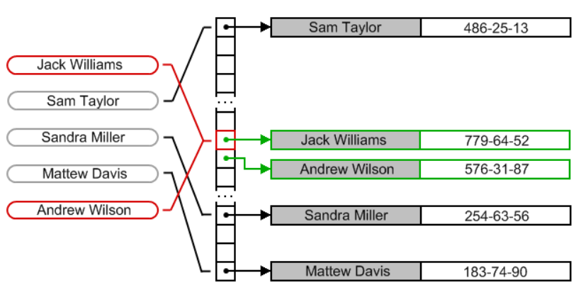
Hash ADT
Operasi :
Sama dengan Dictionary ADT
Lebih ke arah teknis programming
Python dict, Java HashMap, C# Dictionary
Insert
Update
Delete
Access
Collision Handling
Load Factor Management
Resizing

Slide 21
Hash ADT
import java.util.HashMap;
import java.util.Map;
public class HashADTExample {
public static void main(String[] args) {
// Creating a hash map using HashMap
Map<String, Integer> studentScores = new HashMap<>();
// Insertion
studentScores.put("Alice", 85);
studentScores.put("Bob", 92);
studentScores.put("Charlie", 78);
studentScores.put("David", 95);
// Access
int aliceScore = studentScores.get("Alice");
System.out.println("Alice's score: " + aliceScore);
// Update
studentScores.put("Bob", 94);
// Deletion
studentScores.remove("Charlie");
// Checking for key existence
if (studentScores.containsKey("David")) {
System.out.println("David's score: " + studentScores.get("David"));
}
// Iterating over keys and values
for (Map.Entry<String, Integer> entry : studentScores.entrySet()) {
System.out.println(entry.getKey() + ": " + entry.getValue());
}
}
}
# Using the Hash ADT with Python's built-in dict type
# Creating a hash map
student_scores = {'Alice': 85, 'Bob': 92, 'Charlie': 78, 'David': 95}
# Insertion
student_scores['Eve'] = 88
# Deletion
del student_scores['Charlie']
# Access
alice_score = student_scores['Alice']
# Update
student_scores['Bob'] = 94
print("Student Scores:", student_scores)

Slide 22
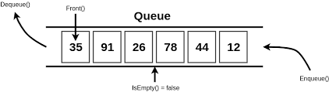
Queue ADT
Struktur data linier yang mengikuti prinsip First-In-First-Out (FIFO).
Regular queue
Priority Queue
Circular Queue
Double-ended Queue
Blocking Queue
Operasi :
Enqueue (Insert)
Dequeue (Remove)
Front (Peek)
IsEmpty
Size

Slide 23
Queue ADT
from collections import deque
class QueueADT:
def __init__(self):
self.queue = deque()
def enqueue(self, value):
self.queue.append(value)
def dequeue(self):
if self.queue:
return self.queue.popleft()
else:
print("Queue is empty. Cannot dequeue.")
return None
def is_empty(self):
return len(self.queue) == 0
def size(self):
return len(self.queue)
queue = QueueADT()
queue.enqueue("Alice")
queue.enqueue("Bob")
queue.enqueue("Charlie")
front_element = queue.dequeue()
next_in_line = queue.queue[0] if queue.queue else None
is_empty = queue.is_empty()
queue_size = queue.size()
print("Front element:", front_element)
print("Next in line:", next_in_line)
print("Queue is empty:", is_empty)
print("Queue size:", queue_size)
import java.util.LinkedList;
import java.util.Queue;
public class QueueADTExample {
public static void main(String[] args) {
// Creating a queue using LinkedList
Queue<String> queue = new LinkedList<>();
// Enqueue (Insertion)
queue.offer("Alice");
queue.offer("Bob");
queue.offer("Charlie");
// Dequeue (Removal)
String frontElement = queue.poll(); // Removes "Alice"
// Front (Peek)
String nextInLine = queue.peek(); // Returns "Bob" without removing it
// IsEmpty
boolean isEmpty = queue.isEmpty();
// Size
int queueSize = queue.size();
System.out.println("Front element: " + frontElement);
System.out.println("Next in line: " + nextInLine);
System.out.println("Queue is empty: " + isEmpty);
System.out.println("Queue size: " + queueSize);
}
}

Slide 24
Queue ADT
Implementation of Queue:
Supermarket Checkout Lines
Print Queue in Offices
Online Order Processing
Call Centers
Traffic at Toll Booths
Software Job Scheduling
…

Slide 25
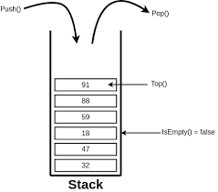
Stack ADT
Struktur data linier yang mengikuti prinsip Last-In-First-Out (LIFO).
import java.util.Stack;
public class StackADTExample {
public static void main(String[] args) {
// Creating a stack using Stack
Stack<String> stack = new Stack<>();
// Push (Insertion)
stack.push("Alice");
stack.push("Bob");
stack.push("Charlie");
// Pop (Removal)
String topElement = stack.pop(); // Removes "Charlie"
// Peek (Top)
String newTop = stack.peek(); // Returns "Bob" without removing it
// IsEmpty
boolean isEmpty = stack.isEmpty();
// Size
int stackSize = stack.size();
System.out.println("Top element: " + topElement);
System.out.println("New top element: " + newTop);
System.out.println("Stack is empty: " + isEmpty);
System.out.println("Stack size: " + stackSize);
}
}
class StackADT:
def __init__(self):
self.stack = []
def push(self, value):
self.stack.append(value)
def pop(self):
if self.stack:
return self.stack.pop()
else:
print("Stack is empty. Cannot pop.")
return None
def peek(self):
if self.stack:
return self.stack[-1]
else:
print("Stack is empty. Cannot peek.")
return None
def is_empty(self):
return len(self.stack) == 0
def size(self):
return len(self.stack)
stack = StackADT()
stack.push("Alice")
stack.push("Bob")
stack.push("Charlie")
top_element = stack.pop()
new_top = stack.peek()
is_empty = stack.is_empty()
stack_size = stack.size()
print("Top element:", top_element)
print("New top element:", new_top)
print("Stack is empty:", is_empty)
print("Stack size:", stack_size)
Operasi :
Push (Insert)
Pop (Remove)
Peek (Top)
IsEmpty
Size

Slide 26
Stack ADT
Implementation of Stack
Function Call Stack in Programming
Undo-Redo Mechanism in Applications
Web Browser Navigation (back & forward button)
Balanced Parentheses Checking
Elevator Button Control
…

